Slide 1
Credit Card Application Project
Alex Nanez

Slide 2
Data Mining Analysis
Research and Data Understanding
Data Cleaning and Understanding
Exploratory Data Analysis
Model Selection
Model Evaluation

Slide 3
Business/Research Problem
The business or research problem I am trying to solve is finding out which attributes are the strongest predictors of whether a credit card application is approved. This is a supervised machine learning classification task where I will construct models to predict whether a credit card application will be approved or not.

Slide 4
Data Cleaning
The challenges of working with this data set was the fact that it was encrypted to protect the confidentiality of the data and that it had missing values for 37 rows (5% of the data).

Slide 5
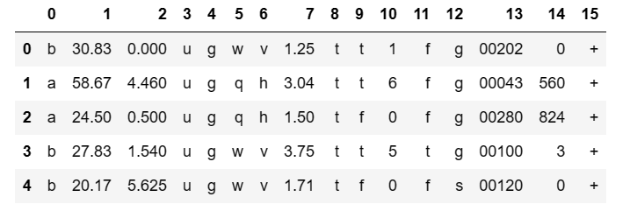
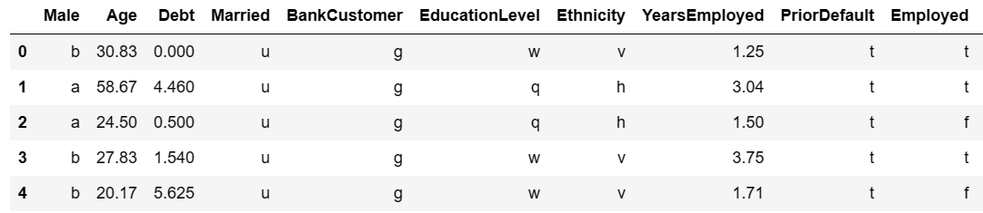
Working Feature Names

Slide 6
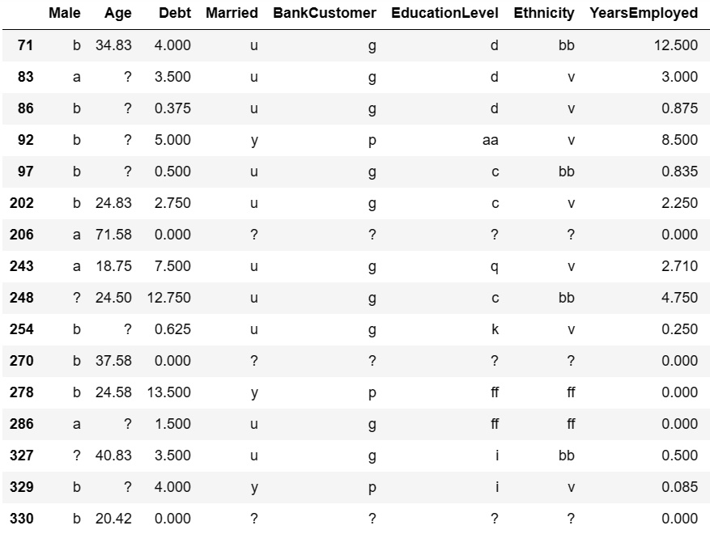
Missing Values (‘?’)

Slide 7
Data Cleaning
Further Steps:
Imputation of Missing Data
Used median for ‘Age’ feature (positively skewed)
Used mode for missing categorical features
Fixing ‘Age’ feature type
Since it has missing values, it was interpreted as an object instead of numerical

Slide 8
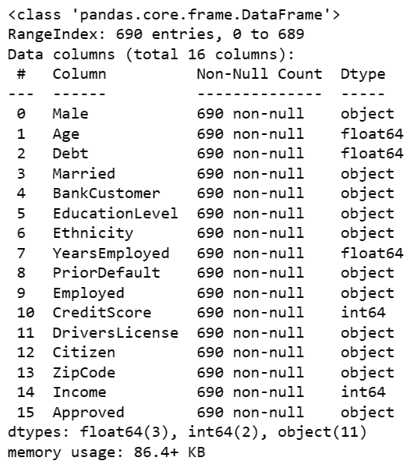
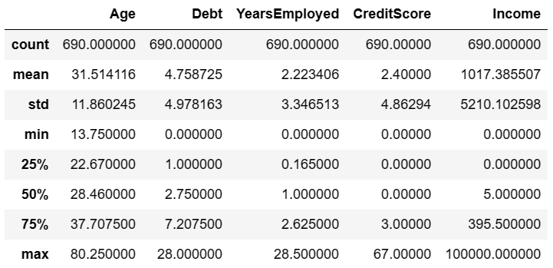
After Imputation

Slide 9
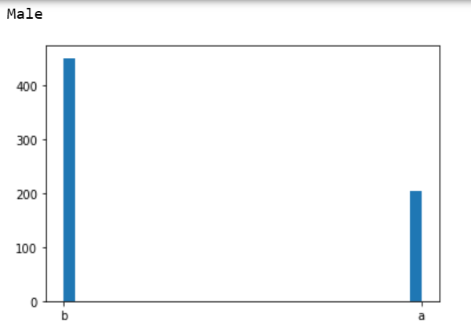
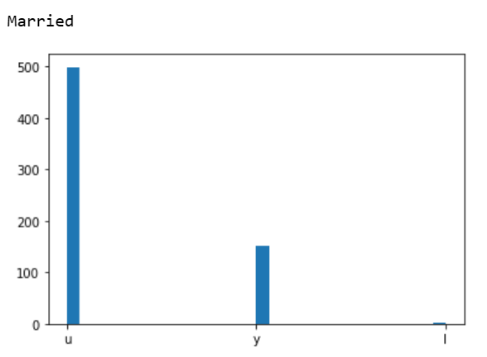
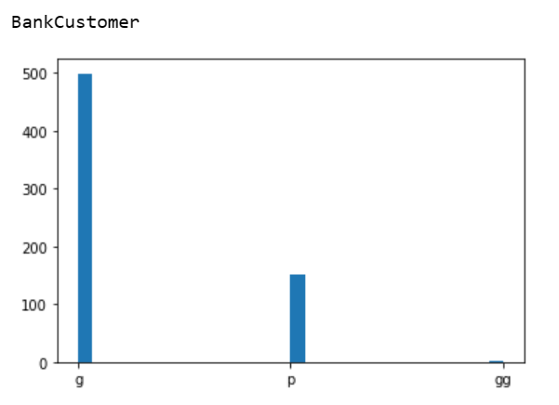
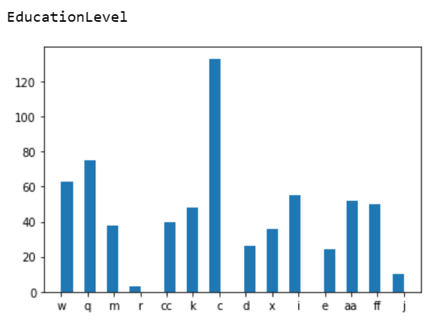
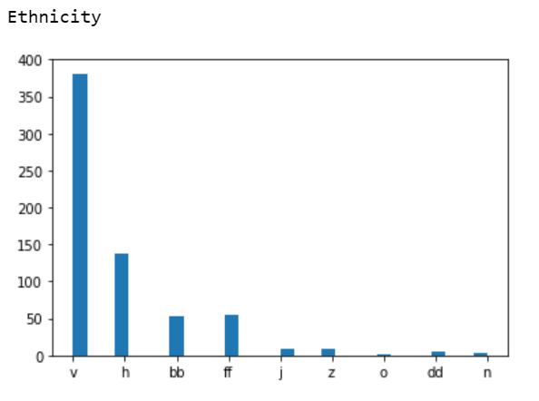
Data Visualization (Categorical)

Slide 10
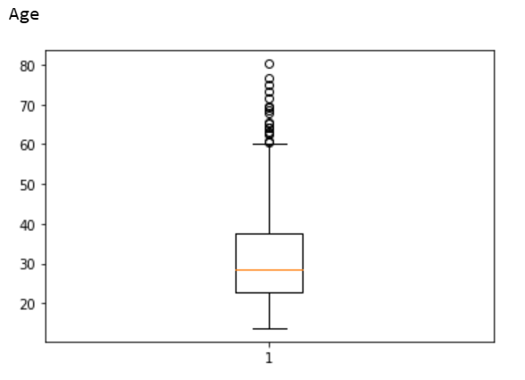
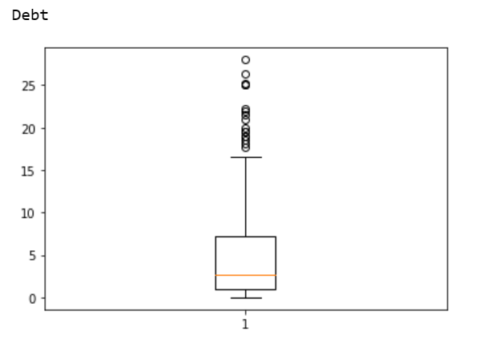
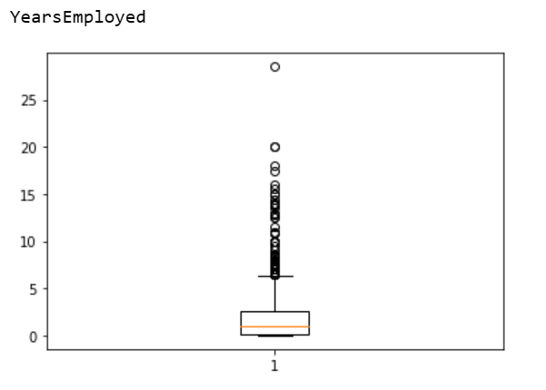
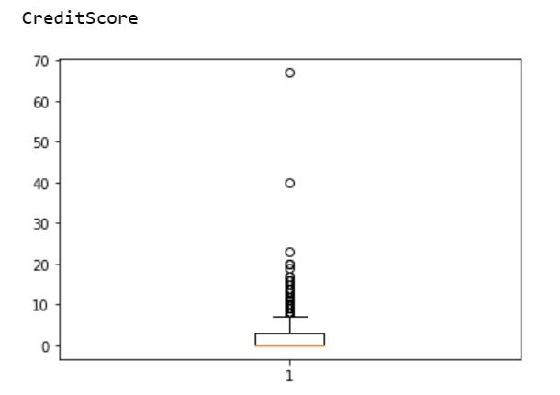
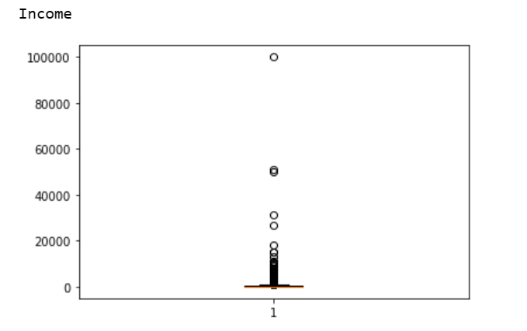
Data Visualization (Numerical)

Slide 11
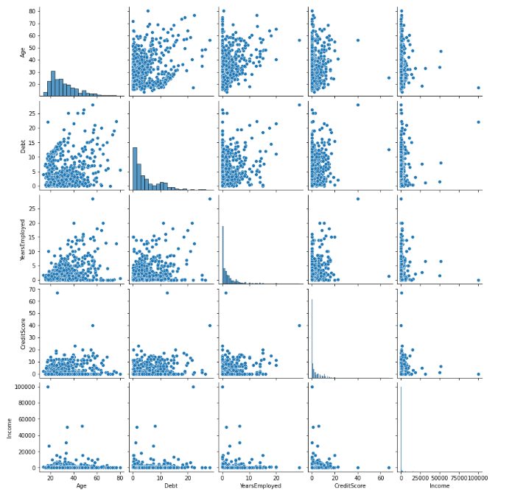
Seaborn Pair Plot

Slide 12
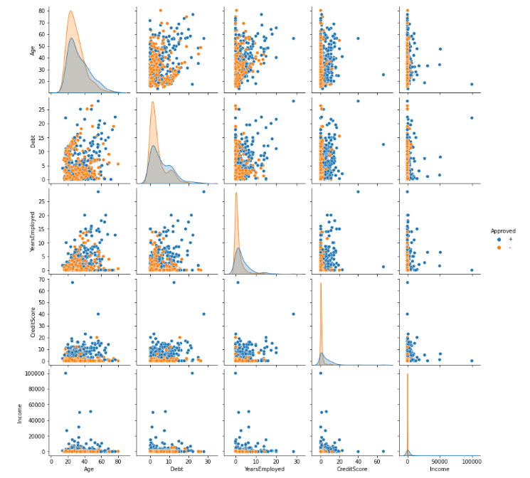
Seaborn Pair Plot (w/ hue)

Slide 13
Model Development
The three machine learning models I decided to use were:
Logistic Regression
Decision Tree
K-Nearest Neighbors

Slide 14
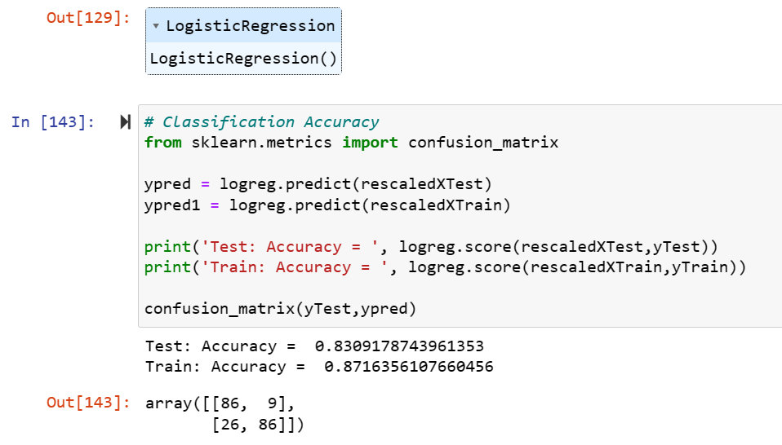
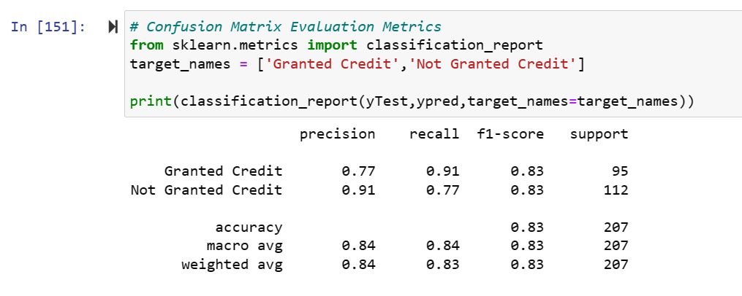
Logistic Regression Model

Slide 15
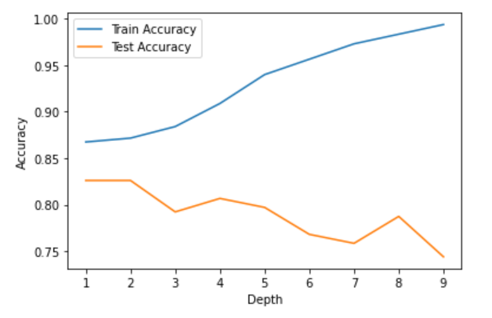
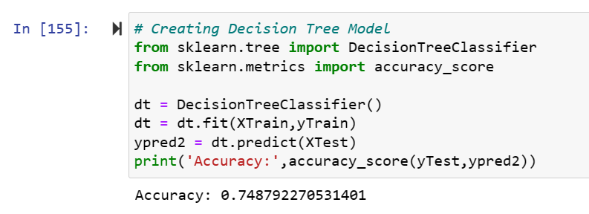
Decision Tree

Slide 16
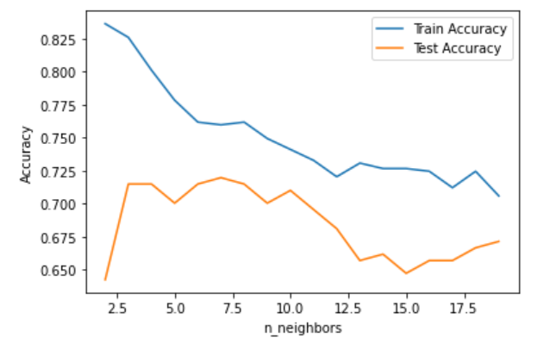
K-Nearest Neighbor
Ideal n_neighbors parameter is 10 (reduces overfitting/underfitting)
Therefore, the final test accuracy score would be 10%

Slide 17
Findings and Conclusions
Looking at the final test accuracy scores for all 3 models, we can see that the Logistic Regression model gave us the best accuracy.
Employing other machine learning models could provide a better accuracy, but I stuck with these 3.
Adjusting the parameters and hyperparameters of each model could have also improved accuracy.

Slide 18
Challenges and Future Directions
Challenges
Working with encrypted data
Missing values
Difficulty incorporating feature engineering due to encryption (also removing outliers
Future Directions
Optimizing Decision Tree by pruning the model more and incorporating criterion and splitter parameters

Slide 19
Key Takeaways
I learned to perform key data preprocessing steps which include data imputation, feature scaling, and label encoding.
I gave appropriate data visualizations after preprocessing the data using matplotlib and seaborn libraries.
I learned to utilize different supervised machine learning models for this classification task, optimizing hyperparameters, and looking at the appropriate evaluation metrics for each model.

Slide 20
Random Forest vs Bagging vs Boosting
All 3 of these models are types of ensemble learning. The purpose of them is to combine several base models in order to form an optimized model with a higher predictive performance.

Slide 21
Bagging
Bagging (also called bootstrap aggregating) is an algorithm that takes random subsets of a data set, trains those models, and finally aggregates the predictions. The purpose of this is to reduce the variance and improve accuracy/stability.
Steps:
Bootstrapping
Building Base Models
Aggregating Predictions

Slide 22
Random Forest
Random forest is an algorithm that is composed of an ensemble of decision trees. Depending on the task (regression or classification), it takes the average case or majority vote from the decision trees.
Steps:
Bootstrapping
Building Decision Trees
Aggregating Predictions

Slide 23
Boosting
Boosting is an algorithm that combines weak models into a stronger model, thus leading to a higher accuracy overall. More weight is given to misclassified examples, which aligns with the primary concept of training weak learners. Types of boosting include AdaBoost (Adaptive Boosting) and XGBoost (Extreme Gradient Boosting).
Examples of Hyperparameters
Number of trees (B) – to prevent overfitting
Shrinkage Parameter (λ) – controls rate of learning
Number of splits (d) – controls complexity

Slide 24
Advantages/Disadvantages
Random Forest
Bagging
Boosting
Effective with noisy or complex data sets
Can help reduce overfitting
However, it is a more complex, labor-intensive model
Not as simple to interpret as, for example, decision tree
Effective with high variance models
Good for large datasets
Possible high bias
Computationally expensive
Effective with complex data sets
Reduces bias (from concept of training weak learners)
Computationally Expensive
Possibility of overfitting

